Slide 1
Kitt Peak Dorm 3 and 4 Renovation
NSF’s NOIRLab
Kitt Peak National Observatory

Slide 2
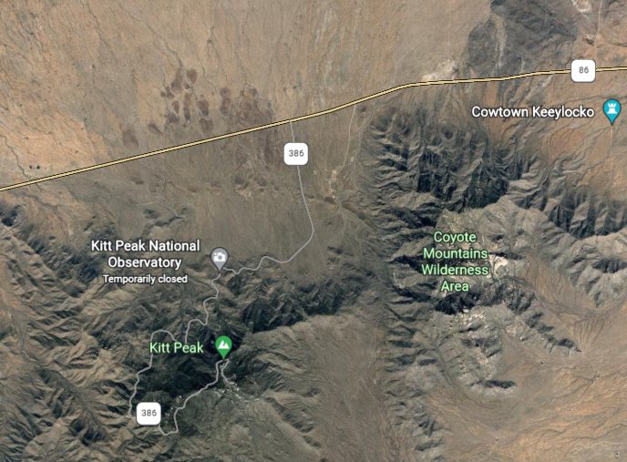
Kitt Peak
1.5 hours SW of Tucson AZ
In Tohona O’odham Nation

Slide 3
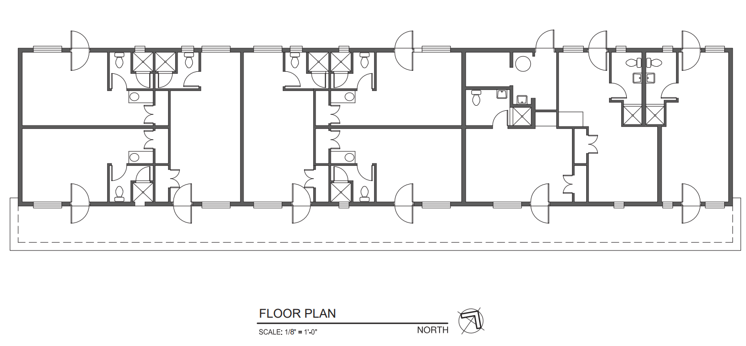
DORM 3
8
9
6
5
1
7
4
3
2

Slide 4
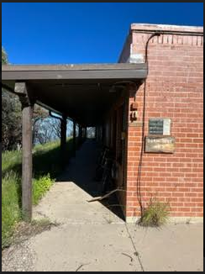
DORM 3
SCOPE OF WORK
Dorm 3 has 9 rooms with one room being shared workout room. Renovate all rooms.
Renovate 9 bathrooms; texture wall, paint, replace flooring with vinyl tiles.
Replace toilets and sinks. Provide a counter for the sink with cabinet.
Remove old carpet or tiles in all rooms and replace with carpet squares.
Re texture interior walls and ceilings. Finish will be Knockdown technique.
Paint interior walls two coats of paint; white semi gloss.
Replace all receptacle outlets, light switch. Color White.
Replace all exterior doors.
Install exterior door levers.
Replace windows with double pane glass with insect screen.
Replace 9 old gas heaters under the windows with energy efficient split units.
Repair awning ceiling. Roll roofing material. Re-coat roof with cool coating.
Replace awning post, replace awning. Ensure pressure treated material is used. Paint post

Slide 5
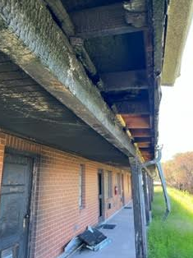
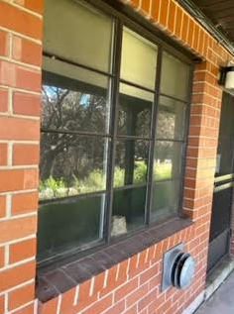
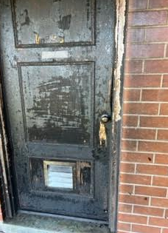
Dorm 3
Awning was damage by fire. If possible to reduce cost repair only the areas damage by the fire.
Replace all windows.
Replace all doors.
Install new door handle hardware.

Slide 6
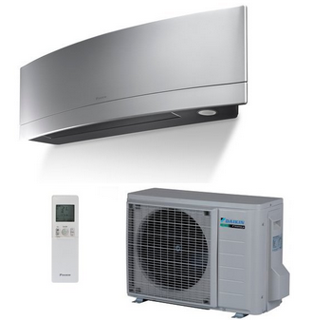
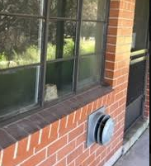
DORM 3
1
Remove old heater unit and replace with energy efficient ductless split unit.
Picture 1: old gas heater
Picture 2: Exhaust vent for gas heater
2

Slide 7
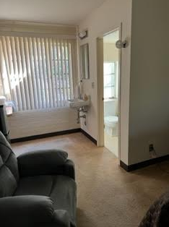
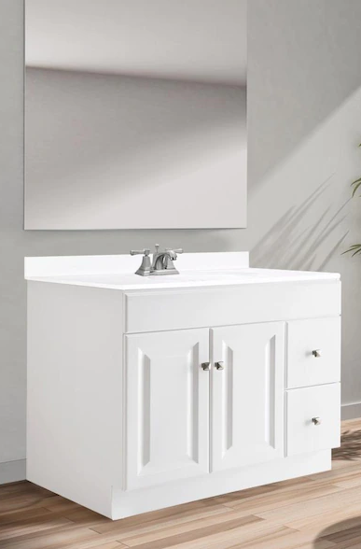
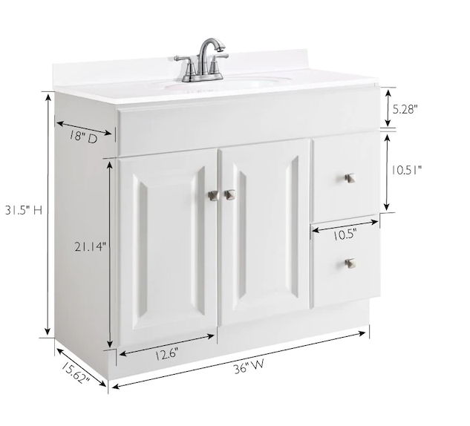
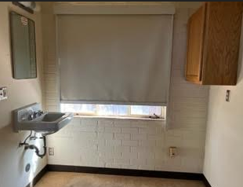
DORM 3
Renovate 9 bathrooms;
Remove everything from walls, texture wall, paint,
Paint interior walls two coats of paint; white semi gloss.
Replace bathroom flooring with vinyl tiles.
Remove old carpet and replace with carpet squares.
Replace toilets and sinks. Provide a counter for the sink with cabinet with mirror.

Slide 8
DORM 3
Blue= new carpet
Bathroom area= new floor tiles
Room 3 is the gym. Install vinyl square tiles.
3

Slide 9
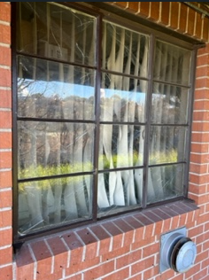
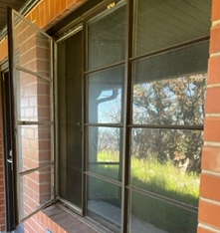
DORM 3
Replace windows with double pane glass with insect screen.
Remove old shut out curtain and replace with new.

Slide 10
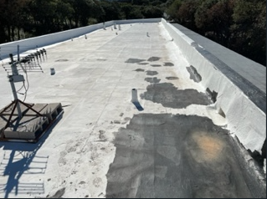
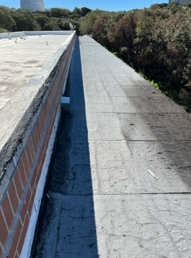
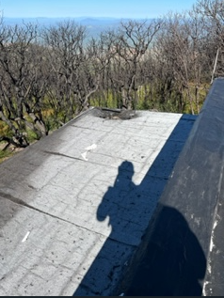
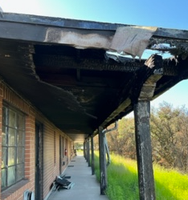
DORM 3
Repair awning.
Install Roll roofing material on awning.
Re-coat roof with cool coating.
Replace awning post. Ensure pressure treated material is used.
Paint post. Exterior paint white.

Slide 11
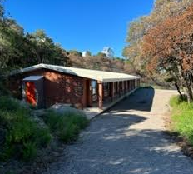
DORM 4
Dorm 4 has 9 rooms with one room as a shared kitchen. Renovate all rooms.
Texture all interior walls; main room and bathrooms. Knock down.
Paint interior walls two coats of paint; white semi gloss.
Remove old carpet and replace with carpet squares. Except for kitchen.
Install new floor tiles in all bathrooms.
Replace all receptacle outlets, light switch. Color White.
Replace exterior door knobs with handles .
Install metal railing between all posts. Ensure pressure treated material is used. Paint post and railing white.
Kitchen; replace vinyl tile, texture walls, paint and install wall cabinets and countertops.
Install three removal metal stairs with railing.

Slide 12
DORM 4
9 rooms with one room as a shared kitchen. Renovate all rooms.
Room 5 is a shared kitchen.
9
8
7
6
5
4
3
2
1

Slide 13
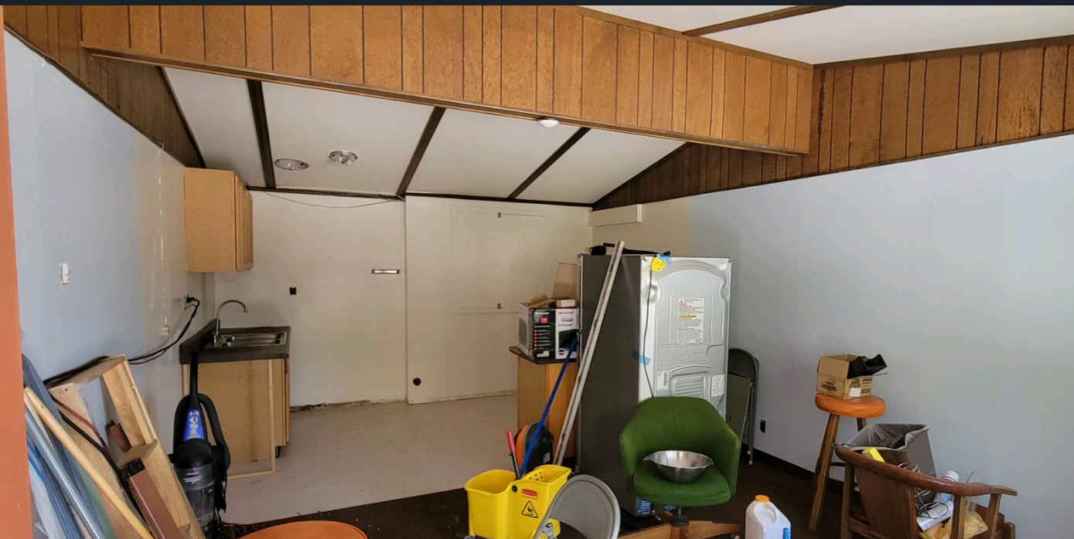
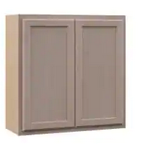
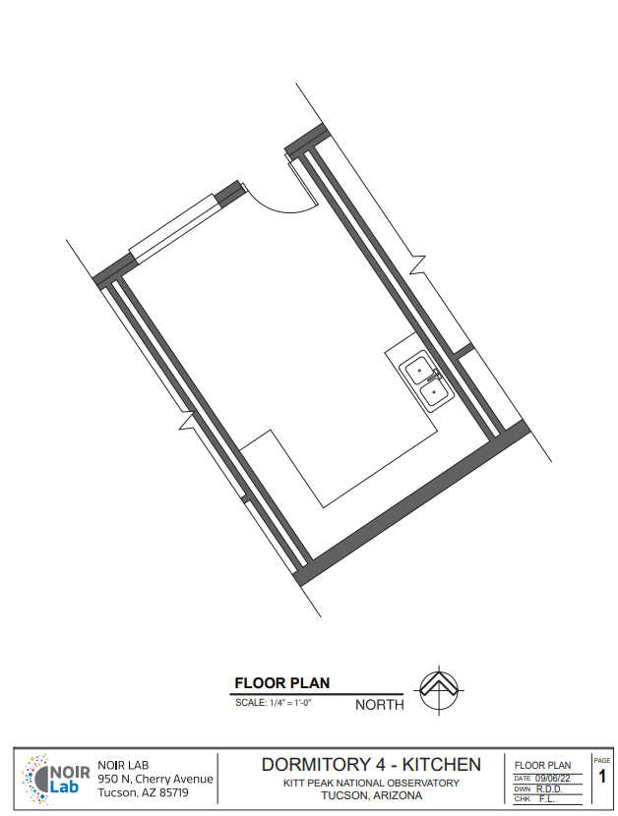
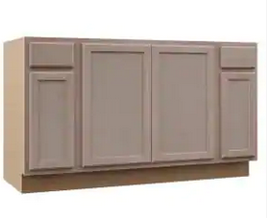
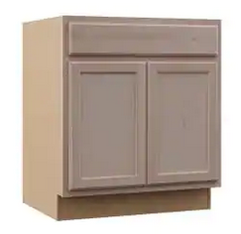
DORM 4
Kitchen.
- Replace kitchen floor tiles with vinyl floor tiles.
Re-texture walls and paint.
Install new cabinets, wall cabinets and white laminate counter top.
Install new sink in the counter top.
Install new sink fixture.

Slide 14
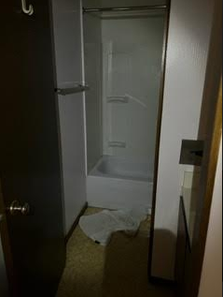
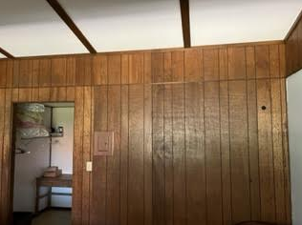
DORM 4
Texture all interior walls; main room and bathrooms. Knock down.
Paint interior walls two coats of paint; white semi gloss.
Remove old carpet and replace with carpet squares.
Install new floor tiles in all bathrooms.
Repaint exterior doors.
Replace door knobs with door handles.

Slide 15
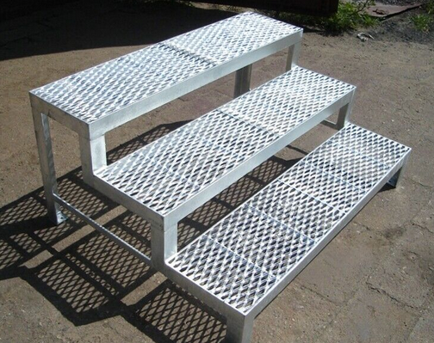
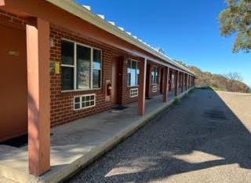
DORM 4
Install metal railing between all posts. Three areas will need an opening for removable stairs.
Install Three removal metal stairs in proper interval.
Opening 1: in font of room 5
Opening 2: in front of room 8
Opening 3: in front of room 2
Paint post and metal railing to match original color to post.

Slide 16
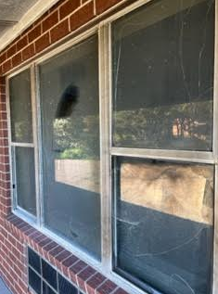
DORM 4
Repair burn damage under awning.
Paint awning.
Replace broken windows for room 8 and 9.
Repair and repaint fascia all around dorm 4.
Repair and repaint Soffit around Dorm 4.

